Slide 1



Slide 2



Slide 3
THE EVOLUTION OF HTML
HTML 4
1997
XHTML
2000
HTML5
Work In Progress
Had some presentational elements
Written in XML
Presentational elements removed
Can be used today
Notes:
Explain: There are three different types of list...
1. Ordered - The order of list items is important
2. Unordered - The order of list items is not important
3. Definition - To explain the meaning of terms

Slide 4
HTML5 DOCTYPE
<!DOCTYPE html>
<!DOCTYPE html PUBLIC
"-//W3C//DTD HTML 4.01 Transitional//EN"
"http://www.w3.org/TR/html4/loose.dtd" />
<!DOCTYPE html PUBLIC
"-//W3C//DTD HTML 4.01 Transitional//EN"
"http://www.w3.org/TR/xhtml/DTD/xhtml1-transitional.dtd" />
Notes:
Explain: Different versions of HTML have different DOCTYPE declarations.

Slide 5
XML DECLARATION
<?xml version="1.0" ?>
Notes:
Explain: If using XHTML, you may see an XML declaration. Note that nothing should appear before the XML declaration (not even a space).

Slide 6
COMMENTS IN HTML
<!-- start of introduction -->
<h1>Current Exhibition</h1>
<h2>Olafur Eliasson</h2>
<!-- end of introduction -->
<!--
<a
href="mailto:info@example.org">Contact</a>
-->
Notes:
Explain: how comments appear inside <!-- and -->
How it is good practice to comment code
Tip: can indicate start end end of sections using comments
Note: how you can comment out sections of code
This hides from users browser view but can be seen in source code

Slide 7
ID ATTRIBUTE
<p>Water and air. So very commonplace are these substances, they hardly attraction attention and yet they vouchsafe our very existence.</p>
<p id="pullquote">Every time I view the sea I feel a sense of calming security, as if visiting my ancestral home; I embark of a voyage of seeing.</p>
<p>Mystery of mysteries, water and air are right there before us in the sea.</p>
Notes:
Explain: The id attribute is used to uniquely identify one element within a page. It is used by CSS and JavaScript.

Slide 8
ID ATTRIBUTE
<p>Water and air. So very commonplace are these substances, they hardly attraction attention and yet they vouchsafe our very existence.</p>
<p id="pullquote">Every time I view the sea I feel a sense of calming security, as if visiting my ancestral home; I embark of a voyage of seeing.</p>
<p>Mystery of mysteries, water and air are right there before us in the sea.</p>
Notes:
Explain: It must always start with letter or underscore (not a number).

Slide 9
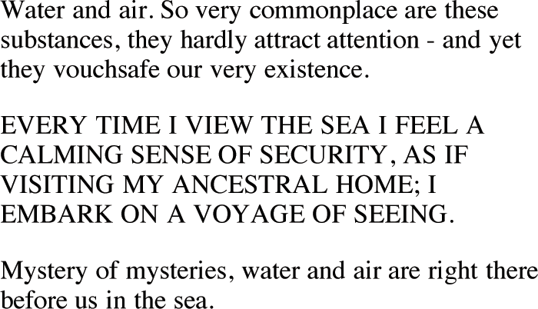

Slide 10
CLASS ATTRIBUTE
<p class="important">For a one-year period from November 2010, the Marugame Genichiro-Inokuma Museum of Contemporary Art (MIMOCA) will host...</p>
<p>Each will showcase works by the artist thematically contextualised under the headings...</p>
<p class="important admittance">Hours: 10:00 - 18:00 (No admittance after 17:30)</p>

Slide 11
CLASS ATTRIBUTE
<p class="important">For a one-year period from November 2010, the Marugame Genichiro-Inokuma Museum of Contemporary Art (MIMOCA) will host...</p>
<p>Each will showcase works by the artist thematically contextualised under the headings...</p>
<p class="important admittance">Hours: 10:00 - 18:00 (No admittance after 17:30)</p>
Notes:
Explain: Classes can be used to distinguish more than one element as being used for a specific purpose.

Slide 12
CLASS ATTRIBUTE
<p class="important">For a one-year period from November 2010, the Marugame Genichiro-Inokuma Museum of Contemporary Art (MIMOCA) will host...</p>
<p>Each will showcase works by the artist thematically contextualised under the headings...</p>
<p class="important admittance">Hours: 10:00 - 18:00 (No admittance after 17:30)</p>
Notes:
Explain: A class attribute can have a space-separated list of values.

Slide 13
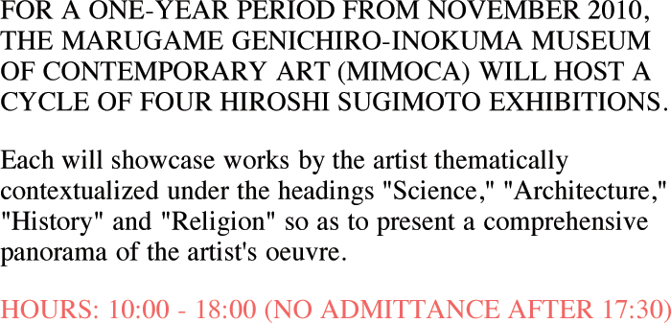

Slide 14
BLOCK ELEMENTS
<h1>Hiroshi Sugimoto</h1>
<p>The dates of the ORIGIN OF ART
exhibition are as follows:</p>
<ul>
<li>Science: 21 Nov - 20 Feb 2010</li>
<li>Architecture: 6 Mar - 15 May
2010</li>
<li>History: 29 May - 21 Aug 2010</li>
<li>Religion: 28 Aug - 6 Nov 2010</li>
</ul>
Notes:
Explain: HTML has concept of block-level and inline elements. Block level elements look like they appear on a new line. The <h1>, <p>, <ul>, and <li> tags are all examples of this.

Slide 15
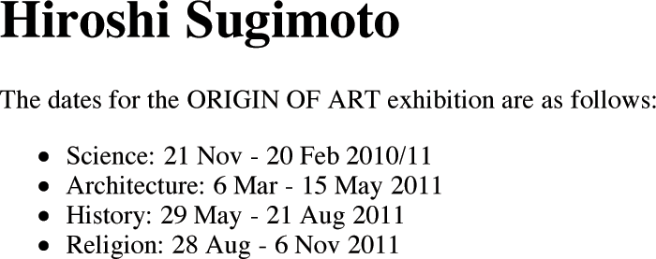
Notes:
Click: lines are drawn around the <h1> <p> and <u> elements to illustrate how they start on a new line

Slide 16
INLINE ELEMENTS
Timed to a single revolution of the planet around the sun at a 23.4 degrees tilt that plays out the rhythm of the seasons, this <em>Origins of Art</em> cycle is organized around four themes: <b>science, architecture, history</b> and <b>Religion</b>.
Notes:
Explain: Inline elements do not start on a new line. Any surrounding text flows around these elements.

Slide 17
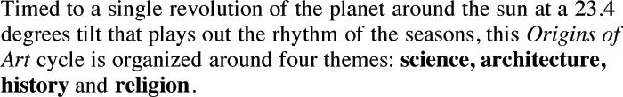
Notes:
Click: borders are shown around the inline elements

Slide 18
GROUPING TEXT &
ELEMENTS IN A BLOCK
<div id="header">
<img src="logo.gif" alt="Anish Kapoor" />
<ul>
<li><a href="index.html">Home</a></li>
<li><a href="bio.html">Bio</a></li>
<li><a href="works.html">Works</a></li>
<li><a href="contact.html">Contact</a>
</li>
</ul>
</div><!-- #header -->
Notes:
Fade in: highlights <div> tags
Explain: how <div> can be used to group together elements into a block level element
Note: how id attribute is used to identify what the <div> element is used for

Slide 19
GROUPING TEXT &
ELEMENTS IN A BLOCK
<div id="header">
<img src="logo.gif" alt="Anish Kapoor" />
<ul>
<li><a href="index.html">Home</a></li>
<li><a href="bio.html">Bio</a></li>
<li><a href="works.html">Works</a></li>
<li><a href="contact.html">Contact</a>
</li>
</ul>
</div><!-- #header -->
Notes:
Explain: The <div> tag can be used to group together elements into a block-level element. Note how the id attribute is used to identify what the <div> element is used for.

Slide 20


Slide 21
GROUPING TEXT &
ELEMENTS INLINE
<p>Anish Kapoor won the Turner Prize in
1991 and exhibited at the
<span class="gallery">Tate Modern</span>
gallery in London in 2003.</p>
Notes:
Explain: The <span> element can only contain inline content.

Slide 22
GROUPING TEXT &
ELEMENTS INLINE
<p>Anish Kapoor won the Turner Prize in
1991 and exhibited at the
<span class="gallery">Tate Modern</span>
gallery in London in 2003.</p>
Notes:
Explain: This example uses a class attribute to identify this content as different from surrounding content.

Slide 24
IFRAMES
<iframe width="450" height="350"
src="http://maps.google.co.uk/maps?
q=moma+new+york&amp;output=embed"
frameborder="0"
scrolling="0">
</iframe>
Notes:
Explain: An iframe acts like it is cutting a window into the current web page. This allows you to see another web page behind it. A common use for iframes is including a Google Map in a page.

Slide 25
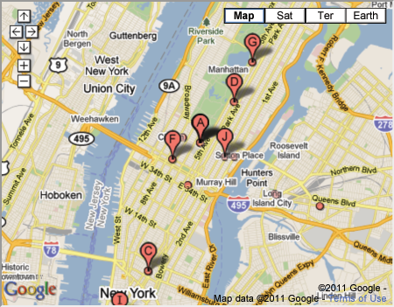

Slide 26
INFORMATION ABOUT
YOUR PAGES
<head>
<meta name="description"
content="An essay on installation art" />
<meta name="robots" content="nofollow" />
<meta http-equiv="Author"
content="Jon Duckett" />
<meta http-equiv="pragma"
content="no-cache" />
</head>
Notes:
Explain: Meta tags provide information about the page. Note that the first pair here includes name and content attributes. The second pair includes http-equiv and content attributes.

Slide 27
ESCAPE CHARACTERS
<p>&copy; 2012</p>
<p>&#169; 2012</p>
<p>The &lt;html&gt; tag</p>
<p>The &#60;html&#62; tag</p>
Notes:
Explain: Some characters are shown using escape characters (or "entity references").
e.g. Copyright and trademark symbols
Explain: Some characters are used in the HTML code itself, therefore need to be represented on the page using escape characters.
e.g. Left and right angled brackets, ampersands

Slide 28
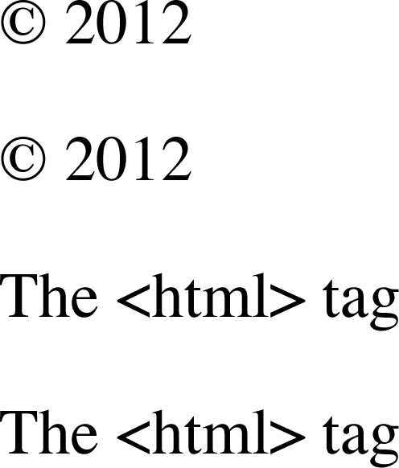

Slide 29
SUMMARY
DOCTYPES tell browsers which version of HTML you are using.
Notes:
Clicks: Load individual bullets

Slide 30
SUMMARY
You can add comments to your code between the
<!-- and --> markers.
Notes:
Clicks: Load individual bullets

Slide 31
SUMMARY
The id and class attributes allow you to identify particular elements.
Notes:
Clicks: Load individual bullets

Slide 32
SUMMARY
The <div> and <span> elements allow you to group block-level elements and inline content together.
Notes:
Clicks: Load individual bullets

Slide 33
SUMMARY
<iframes> cut windows into your web pages through which other pages can be displayed.
Notes:
Clicks: Load individual bullets

Slide 34
SUMMARY
The <meta> tag allows you to supply all kinds of information about your
web page.
Notes:
Clicks: Load individual bullets

Slide 35
SUMMARY
Escape characters are used to include special characters in your pages such as <, >, and ©.
Notes:
Clicks: Load individual bullets

Slide 36
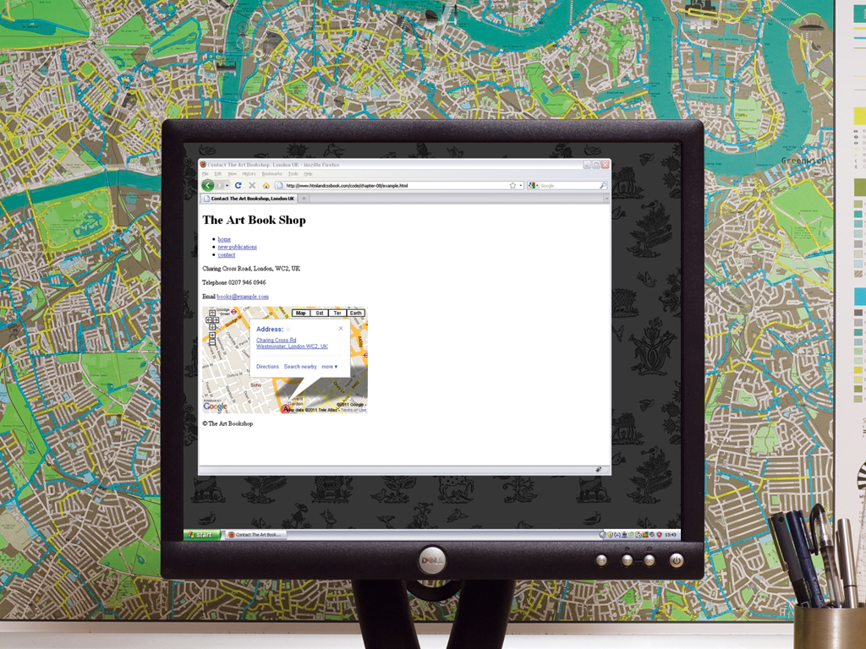

Slide 37


